Slide 1
Assignment two
By jonathan mcdonagh/20074520

Slide 2
Jquery draggable plugin
The jQuery plugin I used was the draggable plugin I sourced it from http://jqueryui.com/draggable/
What this plugin does is it enables a draggable functionality on any element on the web page, allowing users to drag and drop the selected element.
You can move the draggable object by clicking on it with the mouse and dragging it anywhere on the webpage.

Slide 3
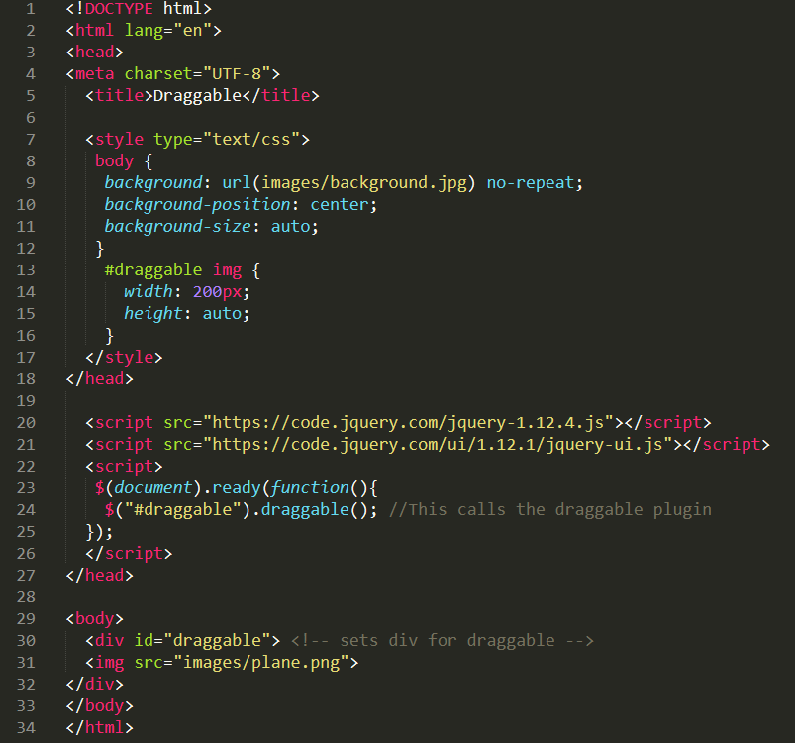
The code for the draggable plugin
As you can see I the draggable plugin requires very little code.
I made the draggable object an image and then added a width and height.
Here is the webpage: Draggable.htm

